Slide 1
Microwave and Satellite Communication
CSTE 3203

Slide 2
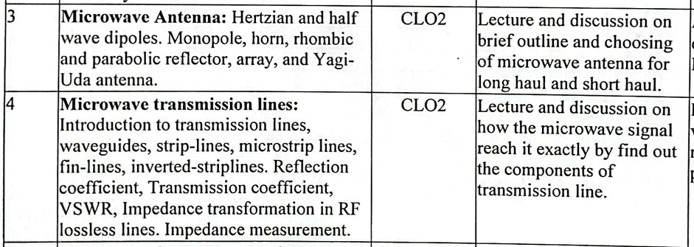

Slide 3
Dipole Antenna

Slide 4
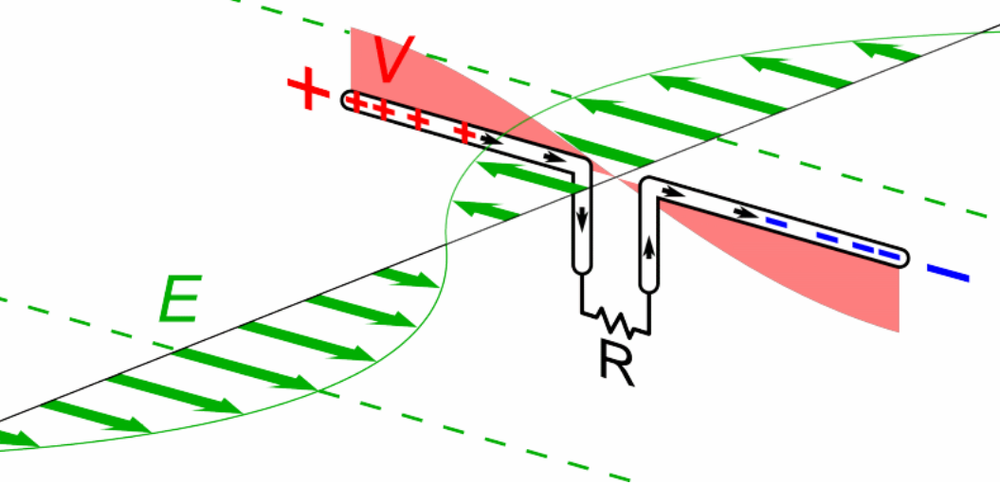
Half Wave Dipole Antenna

Slide 5
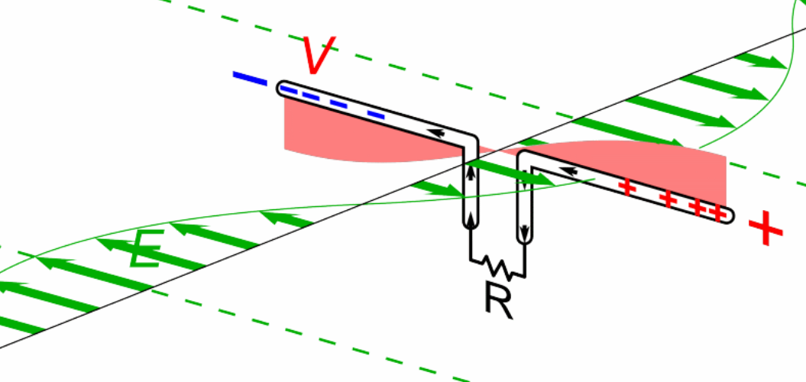
Half Wave Dipole Antenna

Slide 6
Half Wave Dipole Antenna
Animated diagram shows a half-wave dipole antenna receiving a radio wave. The antenna consists of two metal rods connected to a receiver R. The electric field (E, green arrows) of the incoming wave pushes the electrons in the rods back and forth, charging the ends alternately positive (+) and negative (−). Since the length of the antenna is one half the wavelength of the wave, the oscillating field induces standing waves of voltage (V, represented by red band) and current in the rods. The oscillating currents (black arrows) flow down the transmission line and through the receiver (represented by the resistance R).

Slide 7
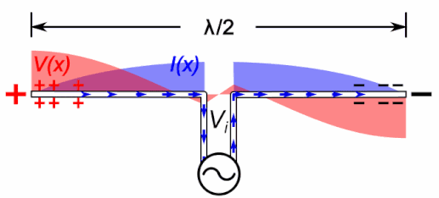
Half Wave Dipole Antenna
Figure shows the voltage and current mainly due to a standing wave along a half wave dipole. The standing waves are storing energy, not transporting power. The current in them is not in phase with the voltage but 90° out of phase. The transmission line applies an oscillating voltage (V_{i}cosωt) between the two antenna elements, driving the sinusoidal oscillation.

Slide 8
Half Wave Dipole Antenna
The edge of the dipole has maximum voltage. This voltage is alternating (AC) in nature. At the positive peak of the voltage, the electrons tend to move in one direction and at the negative peak, the electrons move in the other direction.
The cumulative effect of this produces a varying field effect which gets radiated in the same pattern produced on it. Hence, the output would be effective radiation following the cycles of the output voltage pattern. Thus, a half-wave dipole radiates effectively.

Slide 9
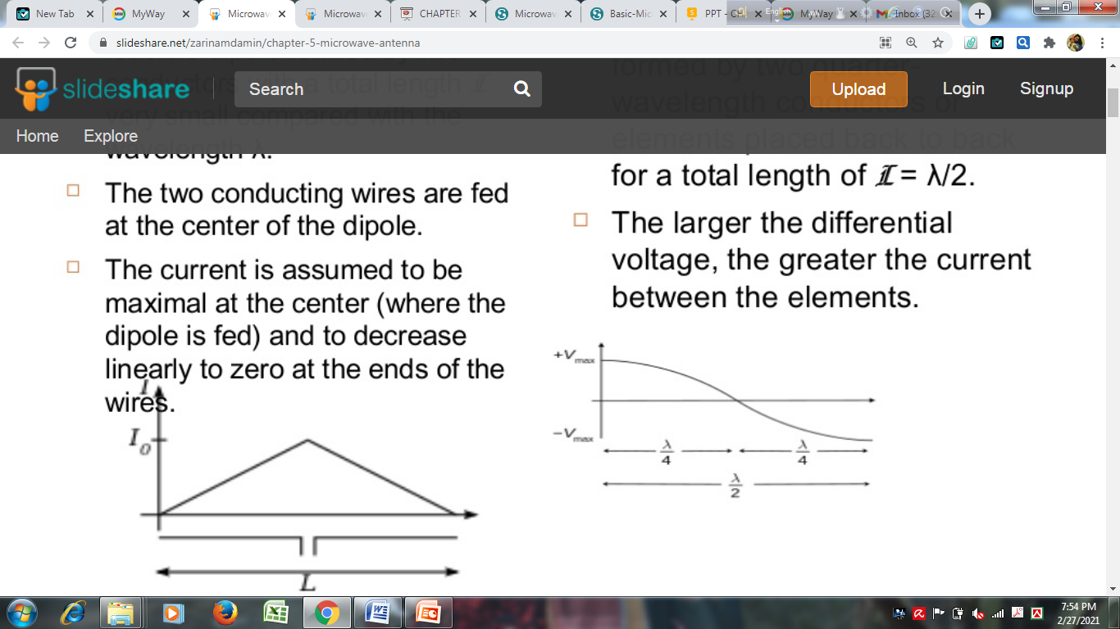
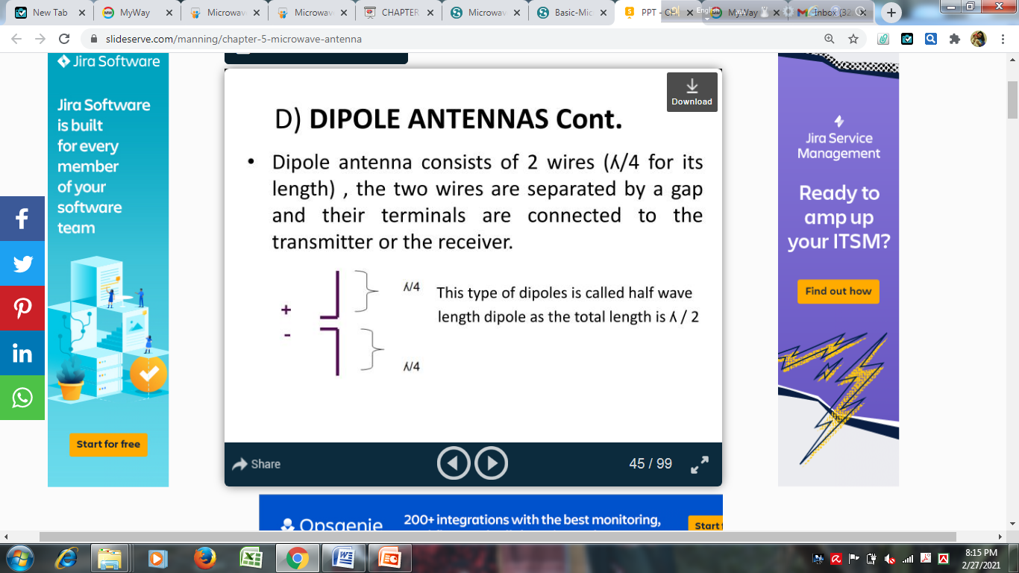
Half Wave Dipole Antenna
Typically a dipole antenna is formed by two quarter wavelength conductors or elements or wires placed back to back for a total length of
L= λ/4 + λ/4 = λ/2.
the two wires are separated by a gap and their terminals are connected to the transmitter or the receiver. The larger the differential voltage, the greater the current between the elements.

Slide 10
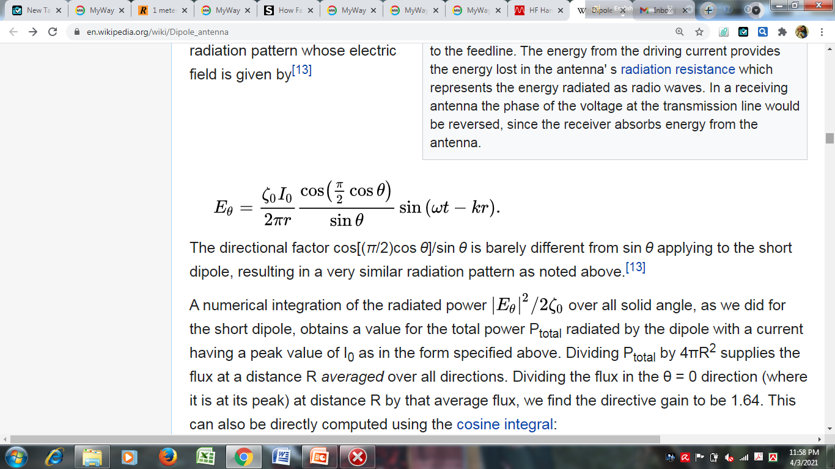
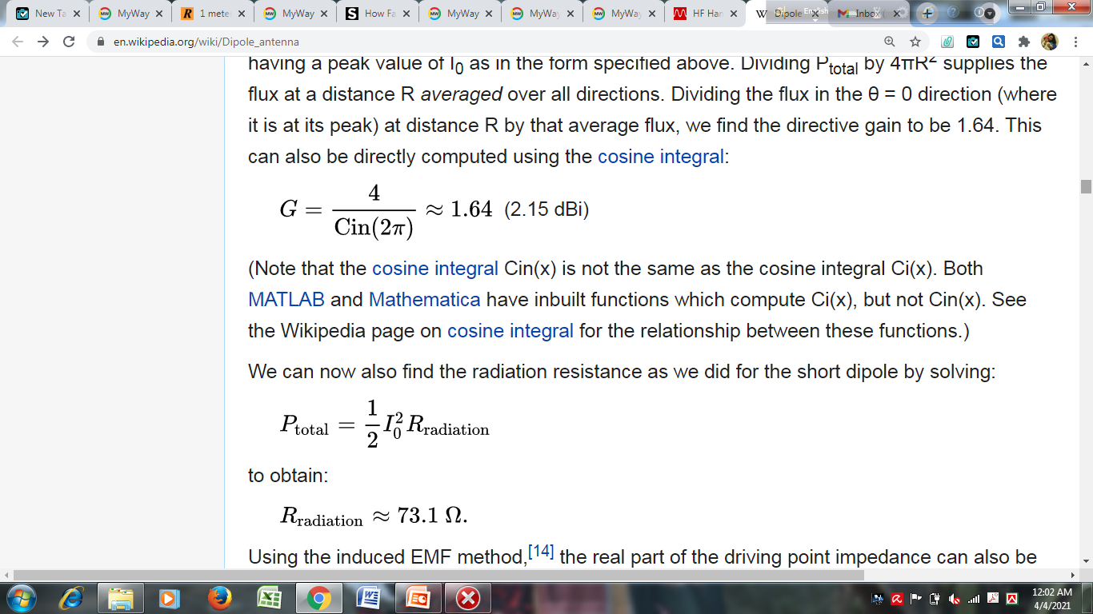
Equations for Dipole Antenna
Peak current at the center (feedpoint) is
I(z)=I₀ cosωt coskz
where k = 2π/λ and z runs from −L/2 to L/2.
For far field, Electric field of radiation pattern is
The directional factor cos[(π/2)cos θ]/sin θ is very nearly same as sin θ applying to the short dipole, resulting in a very similar radiation pattern.
Gain:

Slide 11

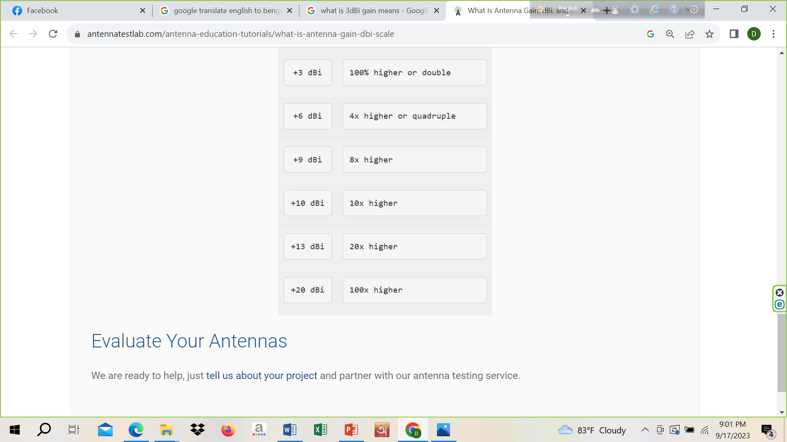

Slide 12
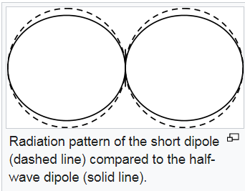
Radiation Pattern

Slide 13
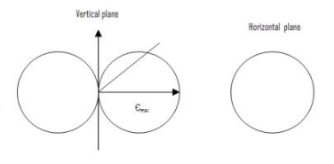
Short Dipole (λ/10) Radiation Pattern
For a free space short-dipole and the radiation pattern shows polar diagram in the vertical plane and a circular in a horizontal plane. Electric field strength E is directional in the vertical (V) plane but is omni-directional on the horizontal (H)plane.

Slide 14
P and R_{rad} Equations for Dipole Antenna
The radiation resistance is usually expressed relative to the maximum current present along an antenna element which for the half-wave dipole and also for the current at the feedpoint.

Slide 15
Impedance
A true half-wave dipole is one half of the wavelength λ in length, where λ = c/f in free space. Such a dipole has a feedpoint impedance consisting of 73 Ω resistance and +43 Ω reactance, thus presenting a slightly inductive reactance. To cancel that reactance, and present a pure resistance to the feedline, the element is shortened by the factor k for a net length :
ℓ= ½ k λ= ½ k c/f
The adjustment factor k which causes feedpoint reactance to be eliminated, depends on the diameter of the conductor. For a typical k of about 0.95 (range 0.94-0.98), the above formula for the corrected antenna length, for a length in metres as 143/f, or a length in feet as 468/f where f is the frequency in megahertz.
Note: (1 meter=3.28 feet)

Slide 16
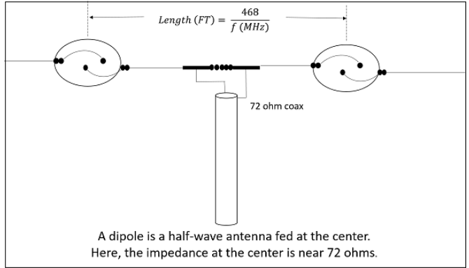

Slide 17
Feeding a Dipole Antenna
Ideally, a half-wave dipole should be fed using a balanced transmission line matching its typical 65–70 Ω input impedance.
Many types of coaxial cable (or "coax") have a characteristic impedance of 75 Ω, which would otherwise be a good match for a half-wave dipole. However coax is a single-ended line whereas a center-fed dipole expects a balanced line (such as twin lead).
Much more common use of 300 Ω twin lead in conjunction with a folded dipole. The driving point impedance of a half-wave folded dipole is 4 times that of a simple half-wave dipole, thus closely matching that 300 Ω characteristic impedance. Most FM broadcast band tuners and older analog televisions include balanced 300 Ω antenna input terminals. However twin lead has the drawback that it is electrically disturbed by any other nearby conductor (including earth); when used for transmitting, care must be taken not to place it near other conductors.

Slide 18
Operating Frequency
Frequency range:
The range of frequency in which half-wave dipole operates is around 3KHz to 300GHz. This is mostly used in radio receivers.

Slide 19
Features
Dipole antenna with a very thin radius is considered.
For a very small dipole antennas, the input impedance is capacitive, which means the impedance is dominated by a negative reactance value.
As the dipole gets larger input resistance increases along with the reactance.
At slightly less than 0.5 the antenna has zero imaginary component to the impedance and the antenna is said to be resonant.
If the length is close to one wavelength, the input impedance becomes infinite.
Dipole antenna consists of two terminals or poles into which radio frequency current flow.
This current and the associated voltage causes the EM or radio signal to be radiated.

Slide 20
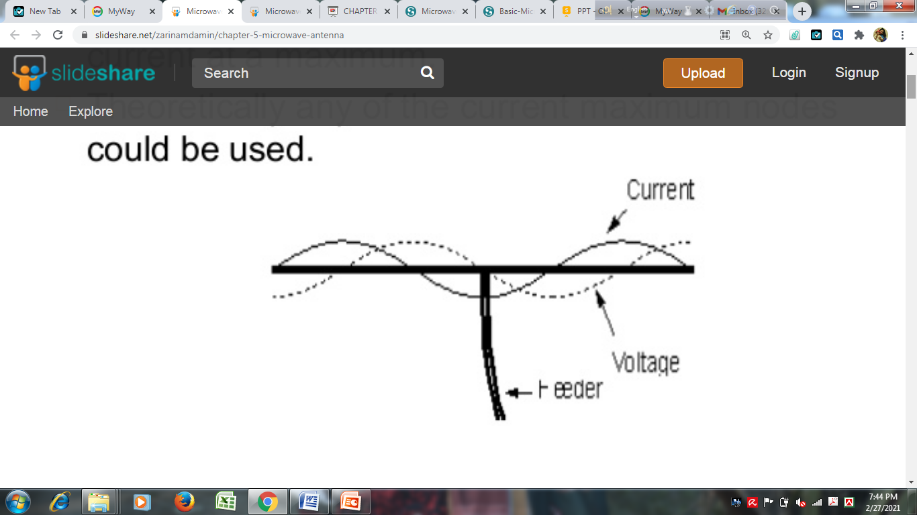
Features
The current distribution along a dipole is roughly sinusoidal.
Zero at the end and maximum at the middle.
Voltage is low at the middle and maximum at the end.
It is generally fed at the center- where current maximum, voltage minimum.
This provides low impedance feed point which is convenient.
High voltage feed point is less convenient and difficult to use.

Slide 21
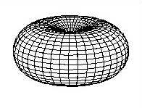
Radiation Pattern
Three dimensional radiation pattern of a vertical half-wave dipole antenna.

Slide 22
Features
The radiation pattern of this half-wave dipole is Omni-directional in the H-plane. It is desirable for many applications such as mobile communications, radio receivers etc.
The figure below indicates the radiation pattern of a half wave dipole in both H-plane and V-plane.
The radius of the dipole does not affect its input impedance in the half wave dipole because the length of this dipole is a half wave and it is the first resonant length. An antenna works effectively at its resonant frequency, which occurs at its resonant length.

Slide 23
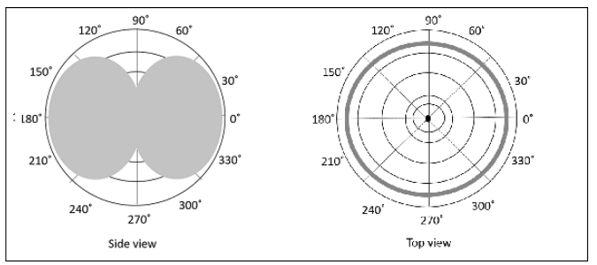

Slide 24
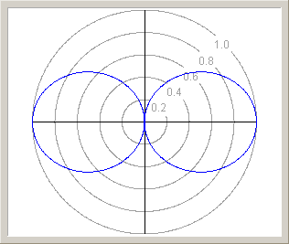
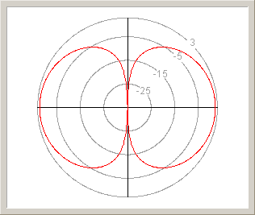
Radiation Pattern and Gain of
Half Wave Dipole Antenna
Radiation pattern of vertical half-wave dipole; vertical section. (left) radiation pattern in linear scale
(right) Gain in decibels isotropic (dBi)
In a half-wave dipole the radiation is maximum perpendicular to the antenna, declining as (sinθ)² to zero on the axis.

Slide 25
Dipole Antenna with Varied Length
If the length of the dipole antenna is changed then the radiation pattern is altered.
As the length of the antenna is extended it can be seen that the familiar figure of eight pattern changes to give main lobes and a few side lobes.
The main lobes move progressively towards the axis of the antenna as the length increases.

Slide 26
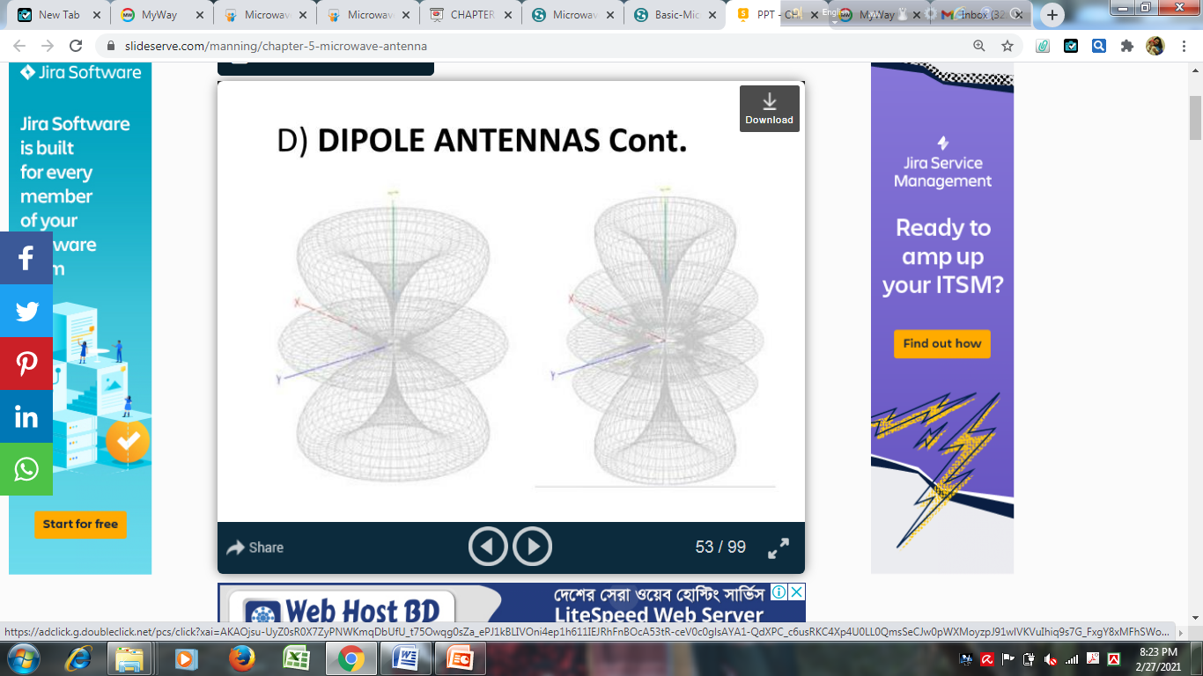
Dipole Antenna with Varied Length

Slide 27
Advantages and Disadvantages
Input impedance is not sensitive.
Matches well with transmission line impedance.
Has reasonable length.
Length of the antenna matches with size and directivity.
Not much effective due to single element.
It can work better only with a combination.

Slide 28
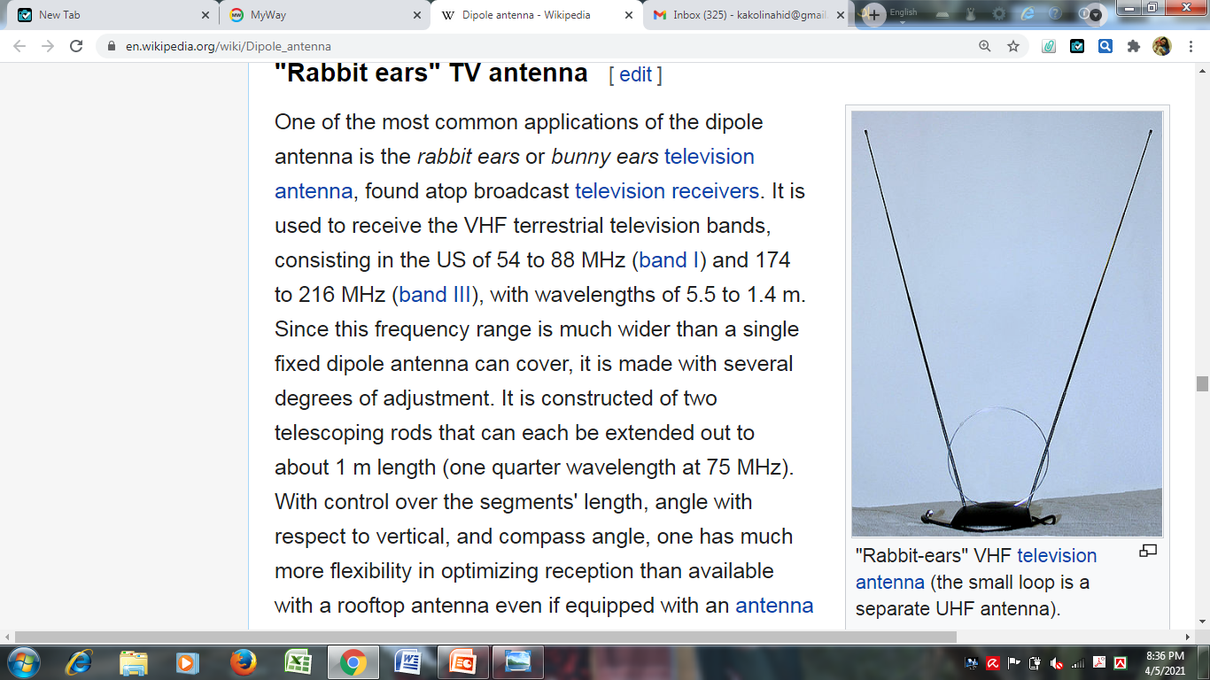
Applications
Used in radio receivers (FM-broadcast-receiving antennas).
Used in television receivers (rabbit ear TV antenna).
When employed with others, used for wide variety of applications.

Slide 29
Transmission line

Slide 30
Transmission line
Two parallel wire transmission line
Co-axial transmission line
Microstrip transmission line

Slide 31
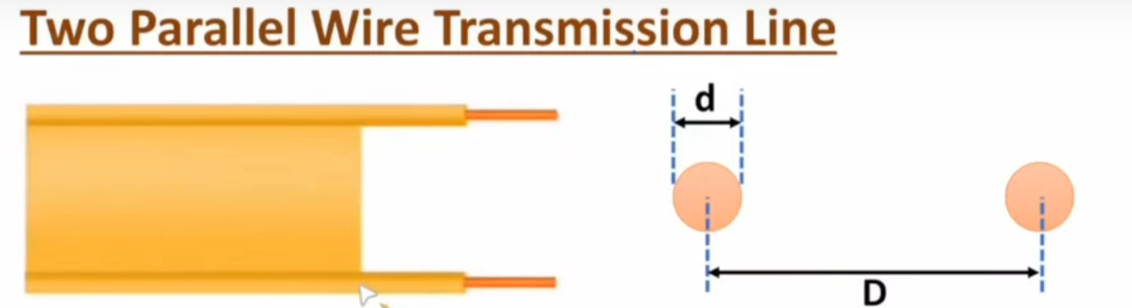

Slide 32
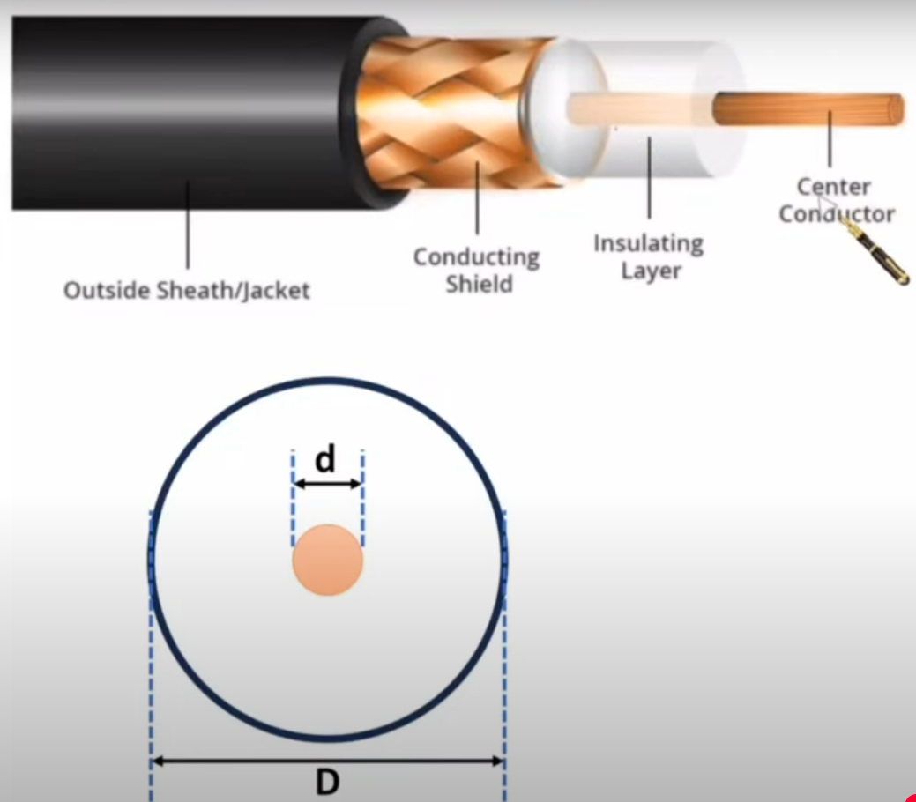

Slide 33
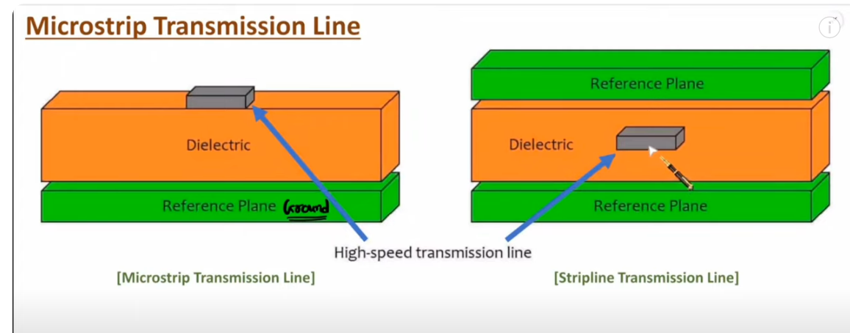

Slide 34
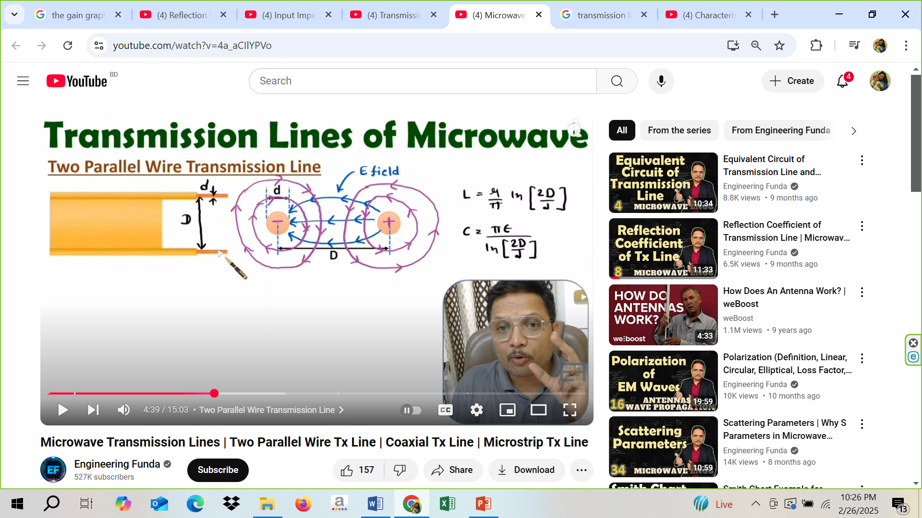

Slide 35
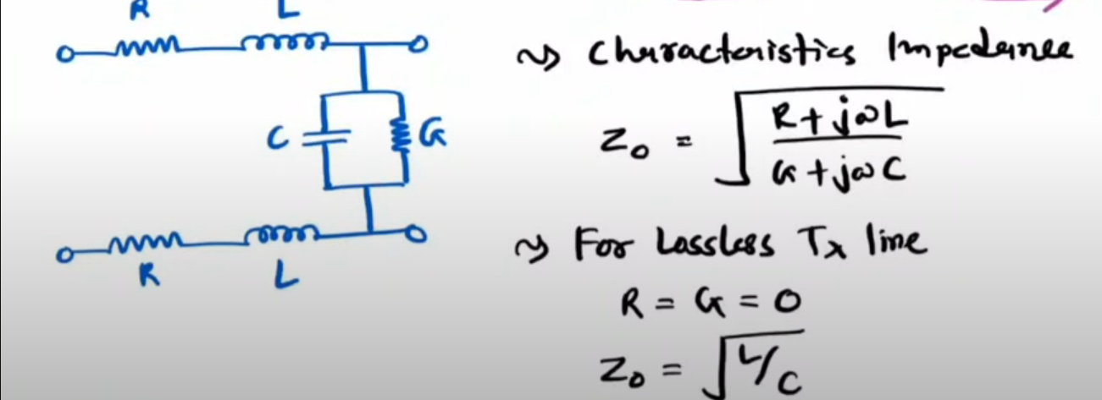

Slide 36
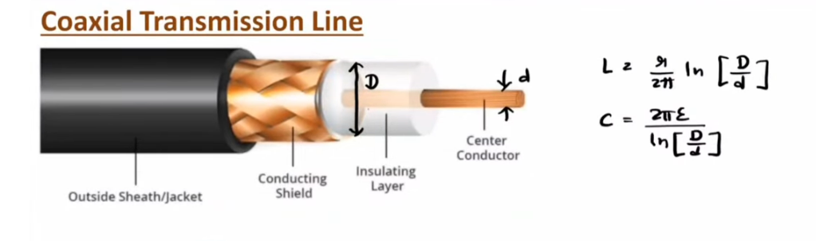

Slide 37
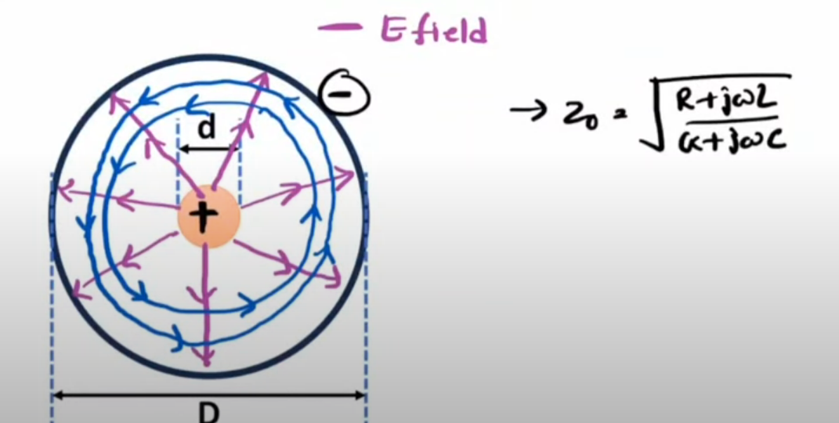

Slide 39
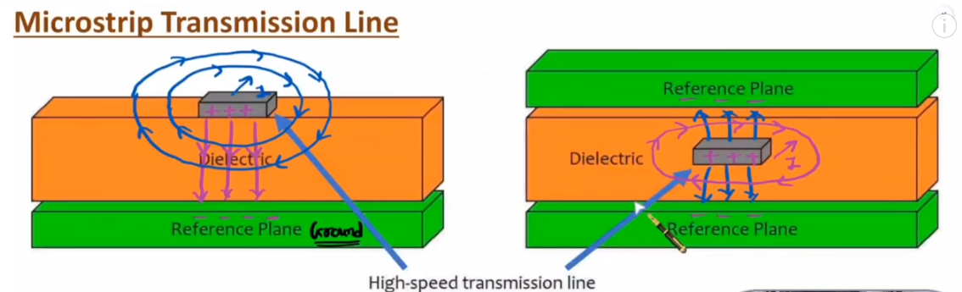

Slide 40
Transmission line equation

Slide 41
Transmission line equation
Based on transmission line equations one can identify parameters of Tx line.
Characteristic impedance
Propagation constant
Phase constant
Attenuation constant
Reflection co-efficient
And VSWR

Slide 42
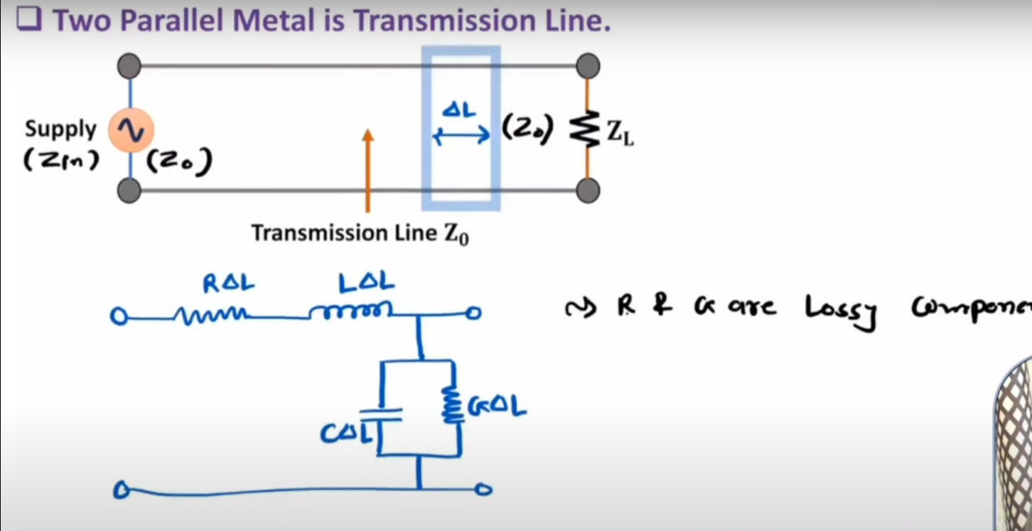

Slide 43
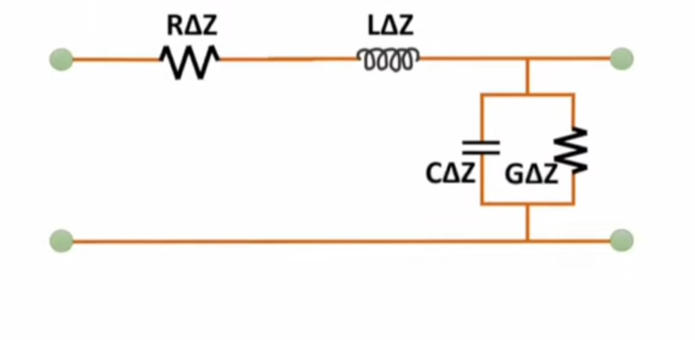

Slide 44
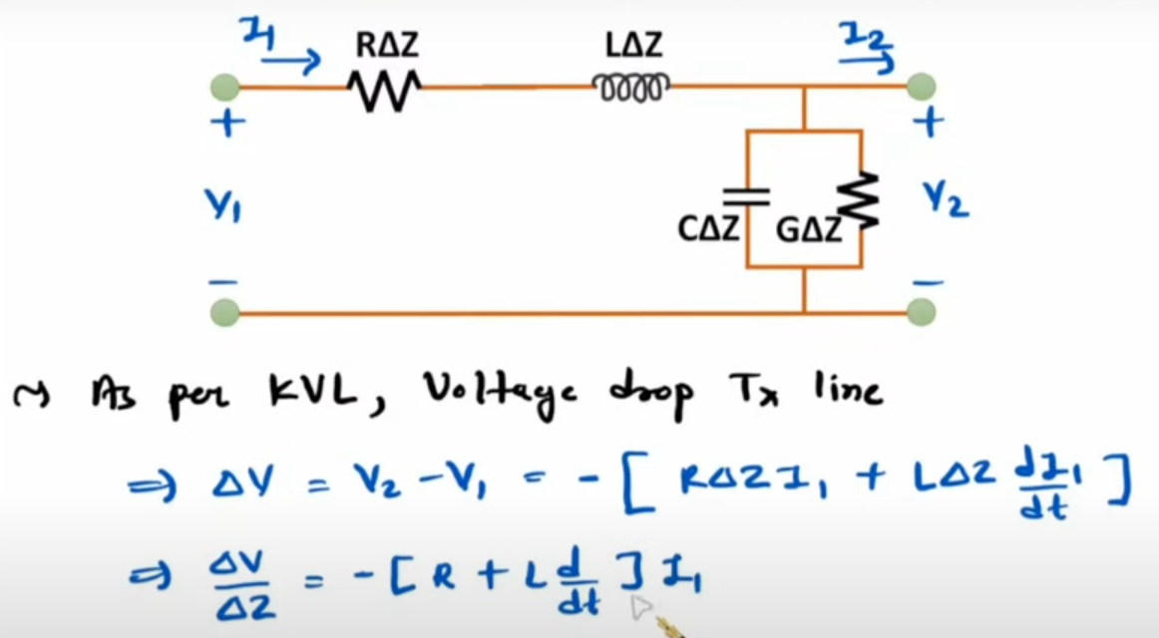

Slide 45


Slide 46


Slide 47


Slide 48


Slide 49


Slide 50


